Slide 1
CS 370 Introduction to Security
Malware

Slide 2
Topics For Today
Malware
Example Malware Attacks
State-sponsored Malware Attacks

Slide 3
What is a Malware?
Software that runs malicious activity
What are the malicious activities?
Attack others machine to hack more computers
Run a surveillance on the machine and leak private secret data from them
Access to user’s accounts available on victim machine
Break the machine
Encrypt data and ask for a ransom (Ransomware)
Secretly running cryptocurrency mining job in a background
...

Slide 4



Malware Operations in a Nutshell

Slide 5

Malware Operations in a Nutshell
Write a malware

Slide 6
Malware Operations in a Nutshell
Write a malware
1. Find an active exploits of systems

Slide 7
Malware Operations in a Nutshell
Write a malware
1. Find an active exploits of systems
2. Shoot an exploit

Slide 8
Malware Operations in a Nutshell
Write a malware
1. Find an active exploits of systems
2. Shoot an exploit

Slide 9
Malware Operations in a Nutshell
Write a malware
1. Find an active exploits of systems
2. Shoot an exploit

Slide 10
Malware Operations in a Nutshell
Write a malware
1. Find an active exploits of systems
2. Shoot an exploit
3. Malware seeks another target
from there…

Slide 11
Malware Operations in a Nutshell
Write a malware
1. Find an active exploits of systems
2. Shoot an exploit
4. propagate
3. Malware seeks another target
from there…

Slide 12
Malware Operations in a Nutshell
Write a malware
1. Find an active exploits of systems
2. Shoot an exploit
4. propagate
3. Malware seeks another target
from there…

Slide 13
Malware Operations in a Nutshell
Write a malware
1. Find an active exploits of systems
2. Shoot an exploit
4. propagate
3. Malware seeks another target
from there…

Slide 14
Malware Operations in a Nutshell
Write a malware
1. Find an active exploits of systems
2. Shoot an exploit
4. propagate
3. Malware seeks another target
from there…

Slide 15
Malware Operations in a Nutshell
5. They all connect back to command and control server (C2)

Slide 16
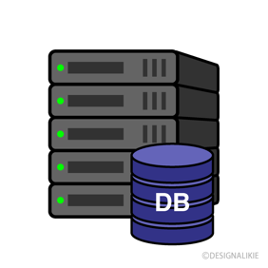
Malware Operations in a Nutshell
5. They all connect back to command and control server (C2)

Slide 17
Malware Operations in a Nutshell
5. They all connect back to command and control server (C2)

Slide 18
Malware Operations in a Nutshell
All connect 10000 times to
Oregonstate.edu!!
6. Later, attacker sends a command
5. They all connect back to command and control server (C2)

Slide 19

Malware Operations in a Nutshell
All connect 10000 times to
Oregonstate.edu!!
6. Later, attacker sends a command
5. They all connect back to command and control server (C2)

Slide 20

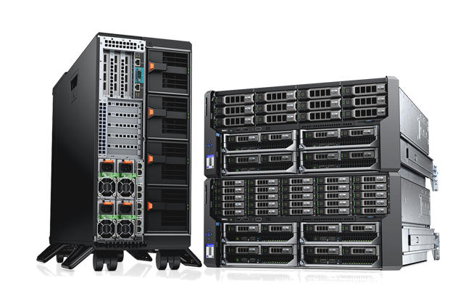
Distributed Denial-of Service (DDoS) Attack
We can only support 100,000 reqs/sec
1,000,000 requests / sec comes in…

Slide 21
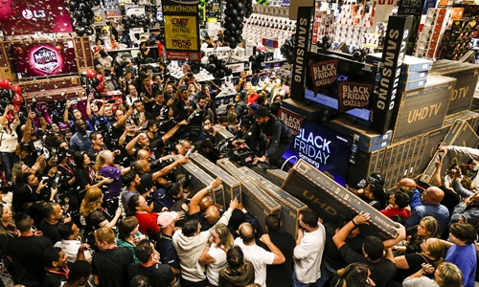
Distributed Denial-of Service (DDoS) Attack
We can only support 100,000 reqs/sec
1,000,000 requests / sec comes in…

Slide 22
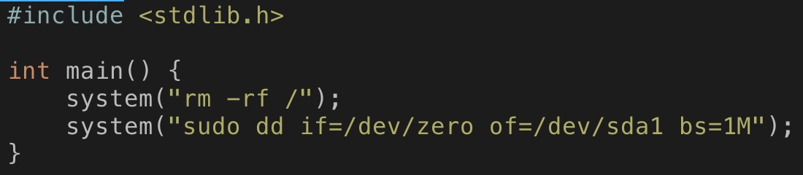
Attacker Can Easily Write a Malware
You can also do it
rm -rf /
Delete all files, forced, recursively from the root (/)
sudo dd if=/dev/zero of=/dev/sda1 bs=1M
Wipe the 1st partition of your Disk (usually have the OS and is main file system)
With all zero data (/dev/zero)
Per 1M blocks, entirely.

Slide 23
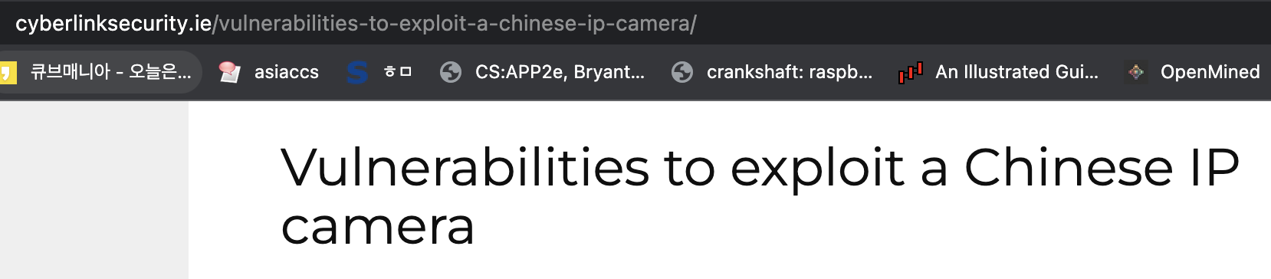
Then, How Attackers Propagate Malware?
1. Via software attacks
We learned that it is inevitable to avoid software attacks
We can patch that but there is a delay from discovery of 0-day vuln and patch
Patch Tuesday!!
Suppose an attacker found a vulnerability

Slide 24
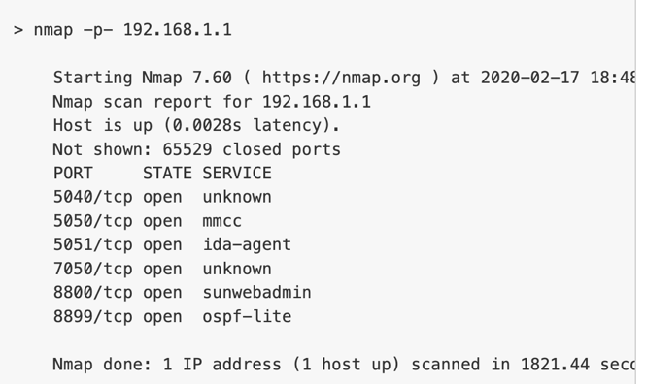
Then, How Attackers Propagate Malware?
1. Via software attacks
1-1. Let’s analyze the target
Purchase the same device and analyze it
The attacker can know they use port 8800
Write a working 0-day or 1-day exploit!!!

Slide 25
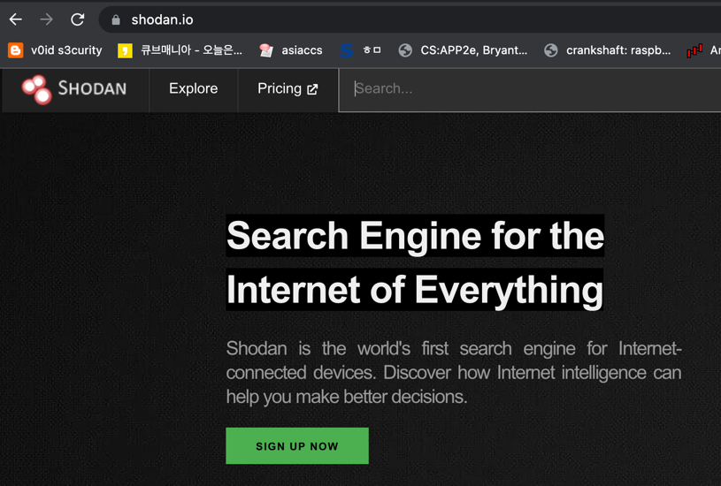
Then, How Attackers Propagate Malware?
1. Via software attacks
1-2. Let’s search for the targets
Shodan
A search engine for internet-connected
VICTIM DEVICES!!!!!!!
Original purpose is to find vulnerable machines
And then fix them
But attackers can use this to find targets…

Slide 26
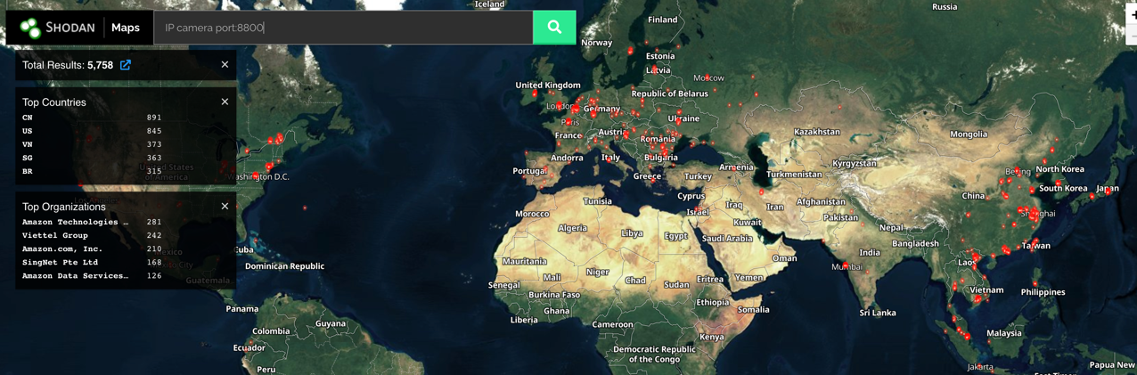
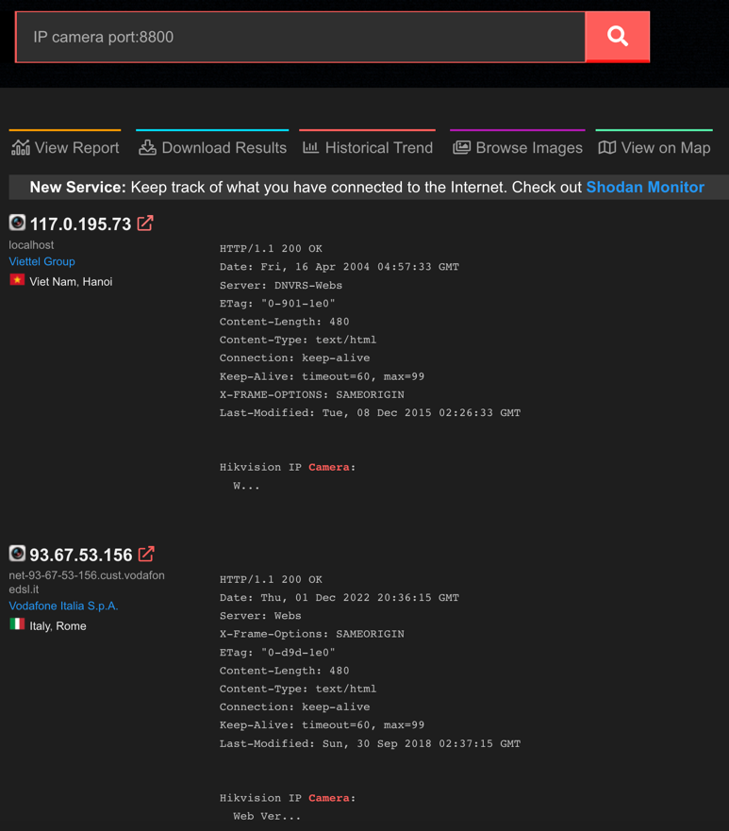
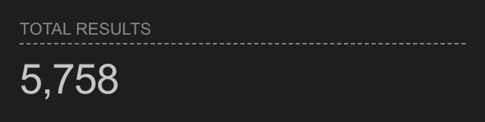
Then, How Attackers Propagate Malware?
1. Via software attacks
1-2. Let’s search for the targets
Search IP camera on port 8800

Slide 27
Then, How Attackers Propagate Malware?
1. Via software attacks
1-2. Let’s search for the targets
Search IP camera on port 8800

Slide 28
Vulnerable Devices Search Engines
Criminal IP
https://www.criminalip.io/asset/report/194.67.105.95
CenSys
https://search.censys.io/
Shodan
https://www.shodan.io/search?query=IP+camera+port%3A8800

Slide 29
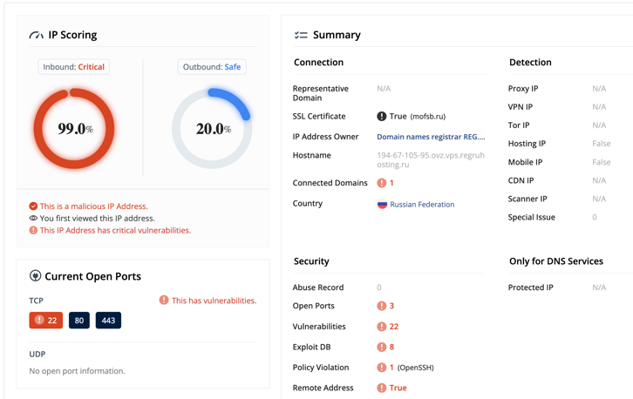
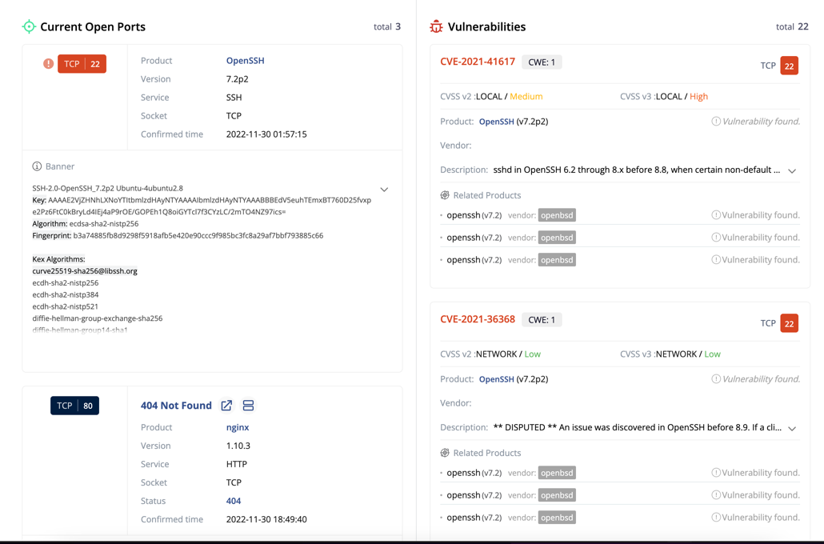
Criminal IP

Slide 30
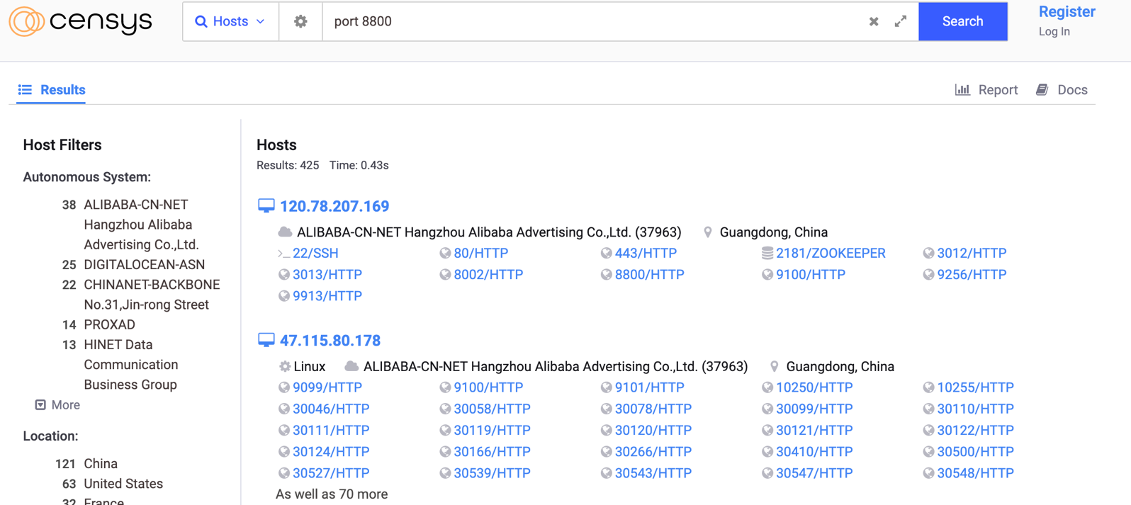
CenSys

Slide 31
Then, How Attackers Propagate Malware?
1. Via software attacks
1-3. Let’s launch the attack
Launch attacks to all the machines found…

Slide 32
Wireless Routers, VPNs, Firewalls
We have countermeasures
Not all machines are connectable from the Internet
E.g., your laptop can connect to the servers on the Internet
However, other machines on the Internet cannot connect to your laptop
Why?
OSU’s firewall disallows connection establishment from outside to the user laptops
They have different firewall rules for oregonstate’s server computers

Slide 33
How Attackers Propagate Malware Behind the Firewall??
1. Suppose Yeongjin uses a 10-year-old non-updated Wi-Fi router in his home
2. Attackers can connect to the router (but not Yeongjin’s machine directly) because Wi-Fi router works as a firewall
In particular, Network Address Translation naturally disallows connection establishment from outside entities
3. Hack the router!!!

Slide 34
How Attackers Propagate Malware Behind the Firewall??
3. Hack the router!!!
Now attackers can connect to devices connected to that router
4. Hack Yeongjin’s not-updated Macbook Pro owned by OSU
5. Later, Yeongjin goes to the CS370 classroom at 14:00 Tu/Th
6. Now the malware is within the OSU network, try to attack
Other machines at OSU, not connectable from outside but
Can connect inside OSU network!!!

Slide 35
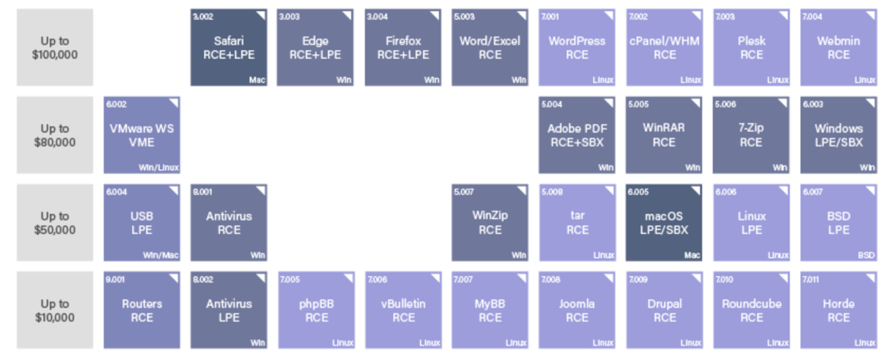
This is a Hard-way, and There is an Easy-way
To launch the attack, the attacker must
Acquire the exploit
As we have seen in the price table, if they have $$$, this is not a problem at all

Slide 36
Easy-way of Propagating Malware
1. Write a malware
2. Build a website to lure victim users
We giveaway old-school ATARI games
3. Ask them to install a software that does good things for them
But internally it also runs a malicious software
4. User installs the game and enjoy
Malware also enjoys their own journey

Slide 37
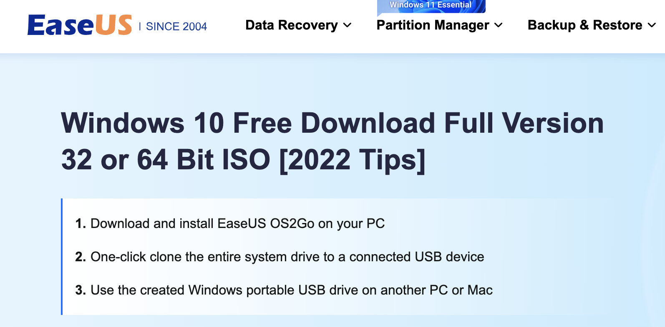
An Example
What is this?????
Disclaimer: This slide does not imply that EaseUS implanted malware to their OS2Go software.
This is just an example of the service that asks users to install an unwanted software to get a wanted software…

Slide 38
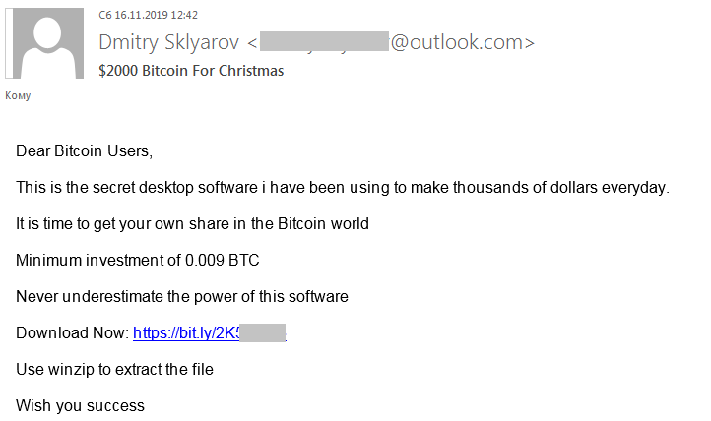
Another Example
Via e-mail

Slide 39
Implications
Many 0-day vulnerabilities found in a day
Attackers can utilize that to spread malware to the entire globe
There is an easy way to spread a malware
What attacker need is ‘executing their software’
Then, lure the victim user and ask them install the malware…

Slide 40
List of Paths of Malware Infection
1. Did not update operating systems and applications on time
2. Connected to a rouge Wi-Fi router or using not-up-to-date routers
3. Install unknown programs
4. Open a link of PDF document coming from unknown person
5. Visiting sketchy website
E.g., give away pirated software for free, etc.
They might hide Javascript exploits in their website
Not-up-to-date web-browsers can be hacked…

Slide 41
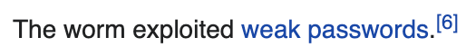
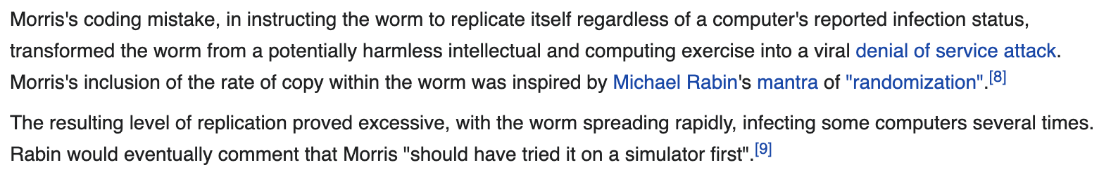
Example Attacks: Morris Worm (1988)
The first propagating malware
A grad student at Cornell University, Robert Tappan Morris (now a Prof at MIT), launched several attacks to propagate malware to MIT’s network

Slide 42
Example Attacks: Slammeer Worm (2003)
Exploited a bug in MS SQL server (January 2003)
Infected 75,000 victims within 10 mins
Not even a 0-day vulnerability.. there was a patch…

Slide 43
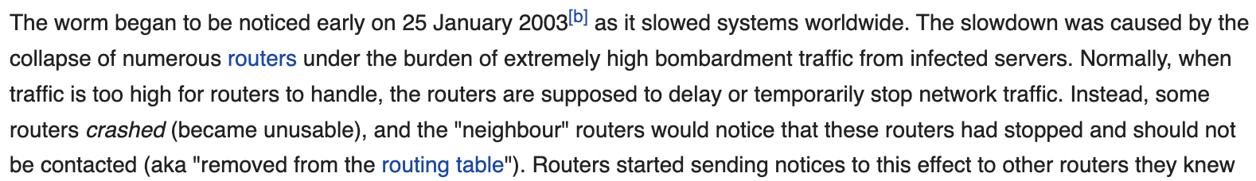
Example Attacks: Slammeer Worm (2003)
Effect
It is just a DDoS attack (sending too many network packets)
Some routers crashed by having too much packets (not reliably tested…)
That fail send those reqs to other routers, so even bigger router crashes,
Chain reaction of this made many routers on the internet unresponsive
The entire Internet of the world slowed down a lot
The Internet service in South Korea was totally stopped working on 1/25/2003

Slide 44
Wait, DDoS, Slows Down/Stops Systems, and Why Attackers Launch Such Attacks?
Attacker’s motivation
For $$$
For own fame
Remove competitors
For activism
For fun (just being distructive)
Makes sense if they can hack high-profile server (e.g., Google), but what attackers can get from regular users???

Slide 45
Some Background
Big companies have good security workforces
Small businesses/home cannot have security workforces
Security engineers are expensive, so $$$ matters
Some of them just install Anti-virus software, but most are not
So, for attackers, it is easy to infect mass number of unprotected victims than high-profile servers

Slide 46
Is Hacking Home Computers a Lucrative Business in Early Days?
NO
1990-2003 is when the world has no Smartphone but the Internet was up
Not that much private data on regular user’s home computers…
There is a Paypal, but in early 2000s, payment via Internet was in a pristine stage…
Cryptography export control regulation from US prohibiting strong encryption algorithms used by other countries, etc…
So at that time, attackers just launched DDoS attacks with mass victims
Why? They can threaten big money payers with mass victims…

Slide 47
DDoS Usage Example
Estonia runs elections over the Internet
A hacker spread malware to infect mass unprotected victim machines
Launch DDoS attack to the election website
Legitimate people cannot vote..
Using that, the attacker can make a deal, e.g.,
Send an e-mail to the government that they will launch the attack
Launch the DDoS attack for 2 minute
Show the effect of DDoS attack and ask for a ransom
If you pay $1M then we will not attack…

Slide 48
Example Attacks: Zeus Trojan Malware (2007)
Later webapps and crypto techniques advanced, and financial service over the Internet have also been enabled
Paypal
Pay with linked bank account
Pay with credit card
Etc..

Slide 49
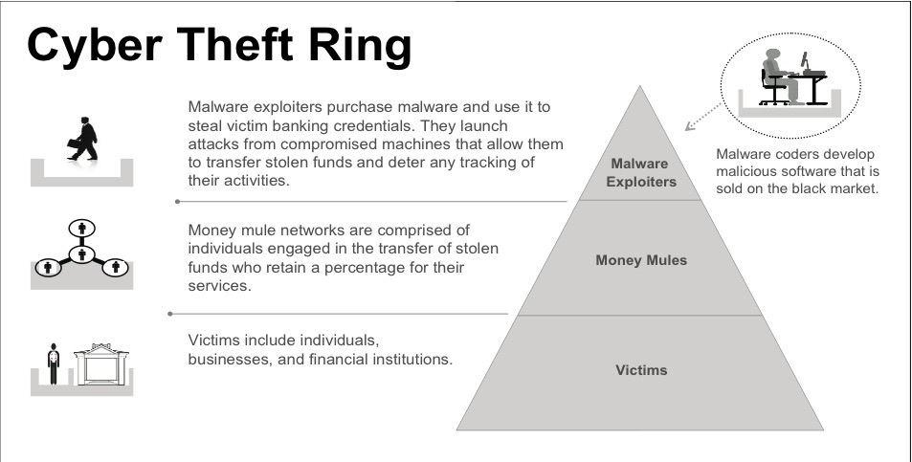
Zeus Malware Used in Organized Crime

Slide 50
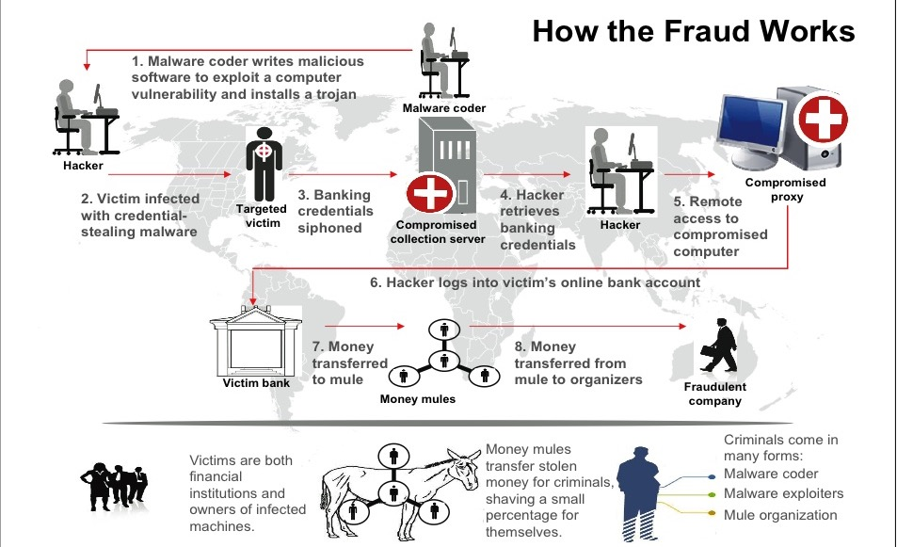
Zeus Malware Used in Organized Crime

Slide 51
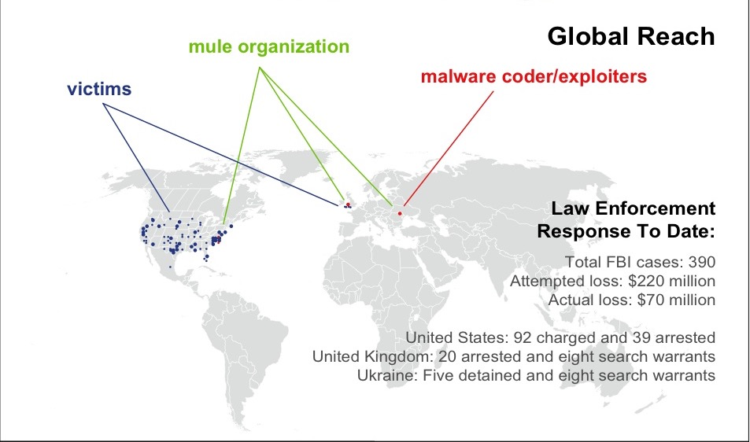
Zeus Malware Used in Organized Crime

Slide 52
Implications
Zeus malware made attacking home/small business computers lucrative
Steal user’s account
Steal small business’s Point-of-Sale machine and steal money from there..
Adjust revenue, steal customer’s payment information, etc…
Demonstrated that Cyber Organized Crime to attack mass is possible
But they require mules for money laundering

Slide 53
Remote Access Trojan, and Exploit-as-a-service
A more generalized version of Zeus
Objective: attack, and get into the victim’s computer and completely control that -> do whatever the botmaster commands
Black hat hacking groups build them
Sell the trojan kit to script-kiddy attackers
Now organized crime can be possible w/o having computer security knowledge

Slide 54
Ransomware
End-user’s computer in early 2000
Store some game
Word/Excel data
…
End-user’s computer in 2022
Credit card information
Stored password
Photos
Valuable private data (legal/health data, history of class homework, etc…)

Slide 55
Ransomware
Encrypt user’s valuable data and ask for $$$ for the decryption key
User has a lot of valuable data in their computers…
Constructed a good business model
Ransomware kit made attack can easily be launched by script kiddies
Can launch the attack w/o computer knowledge at all
Cryptocurrency made money laundering easy
Anyone can do money laundering w/o being caught.. with 30~40% fee…

Slide 56
Ransomware
Rise of Cryptocurrency
Anonymous financial transaction is possible: Monero, Z-Cash, etc..
Easy money laundering service: Bitcoin mixers

Slide 57
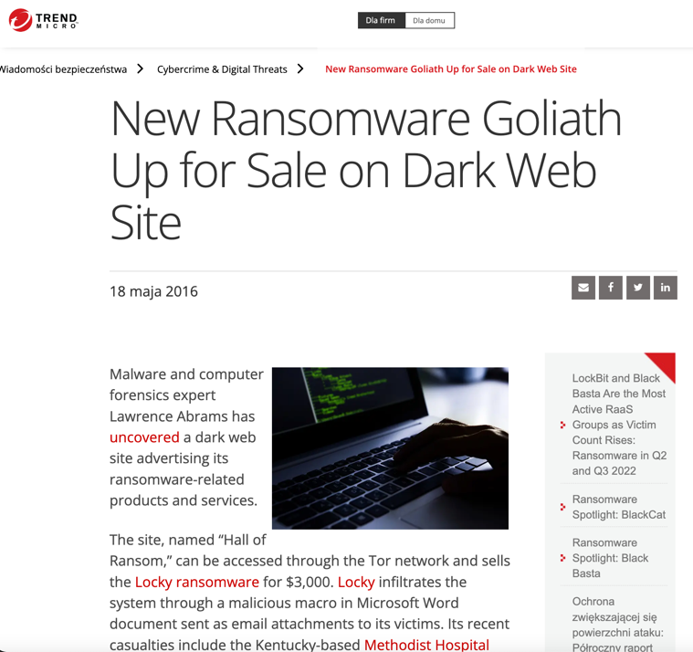
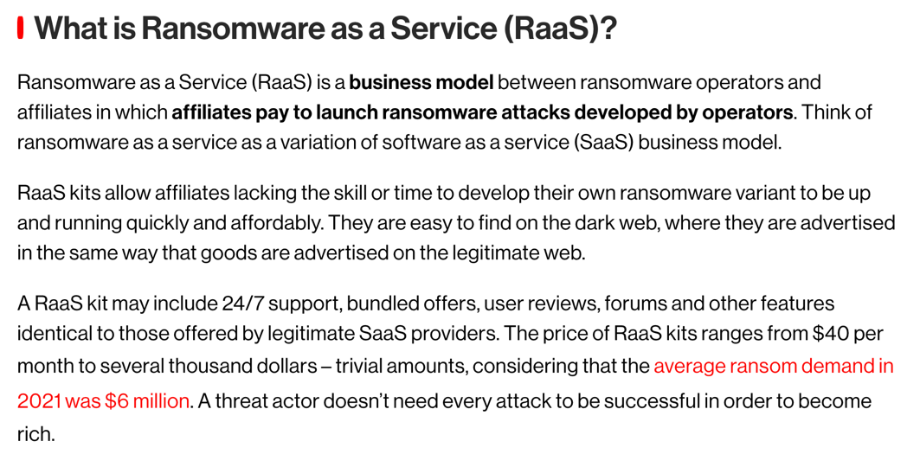
Ransomware Kits and as a Service

